Slide 1
Welcome to my presentation

Slide 2
What is motivation?
Motivation is the psychological force that drives people to take action, make decisions, and achieve goals.

Slide 3
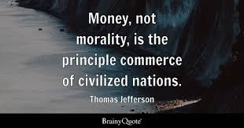
Motivation Type
Intrinsic Motivation
Extrinsic Motivation

Slide 4
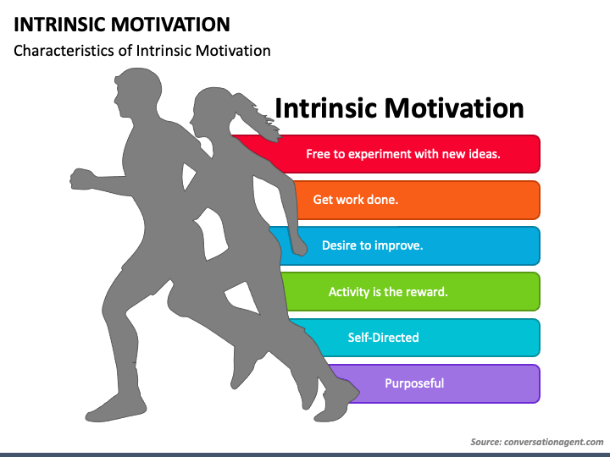
Intrinsic Motivation
Comes from within an individual.
Driven by internal rewards like satisfaction, curiosity, or personal growth.
Example: Studying a subject because you find it interesting and want to learn more.

Slide 5

Extrinsic Motivation
Comes from external factors.
Driven by rewards or avoiding punishments, like money, praise, or grades.
Example: Working hard on a project to earn a bonus or recognition.

Slide 6
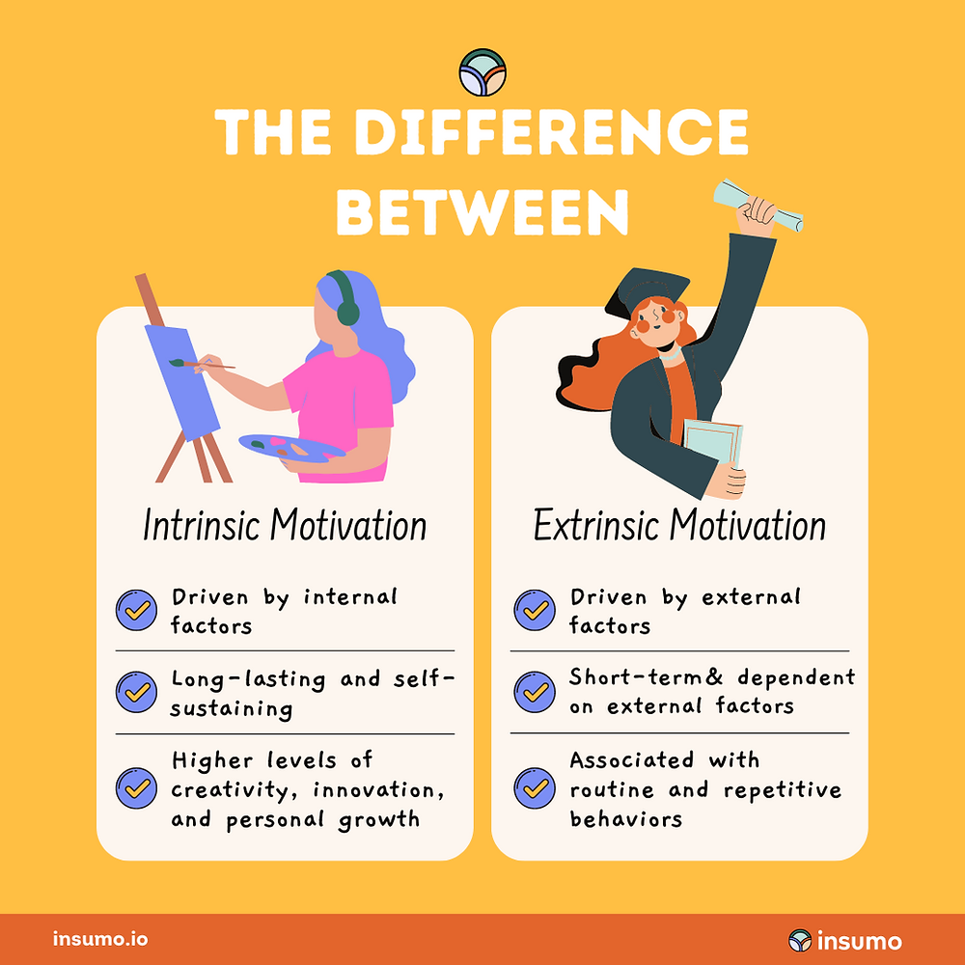

Slide 7

$$\frac{{\left(a+b\right)}^{2}}{2}$$

Slide 8
Numbe 1
Number 2
Number3
Number4
Number5

Slide 10
Thank you Everyone

